Slide 1


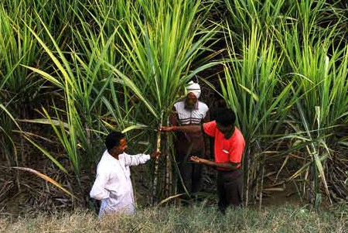
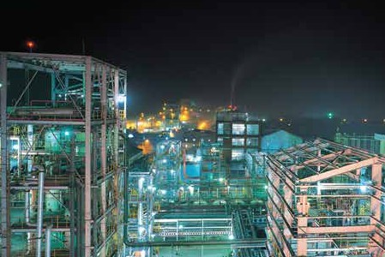

CORPORATE PRESENTATION
June 2026

Slide 2







INDEX
Our Vision Overview
Legacy
Leadership
Changing Landscape Business Financials
ESG
Corporate Social Responsibility Awards & Accolades
3
4
5
7
8
9
16
18
21
2

Slide 3

























OUR VISION
VIBRANT GROWTH WITH TRUST, ENERGISED EMPLOYEES & DELIGHTED CUSTOMERS
Uphold ethical standards.
Be socially responsible. Deliver on promises.
Act with speed.
Adapt continuously. Deliver results.
Encourage diverse views. Build external orientation
Listen to customers.
Build long lasting relationships.
Be innovative. Be Creative.
Foster collaborative working. Promote meritocracy.
Practice empathy & humility.
3

Slide 4




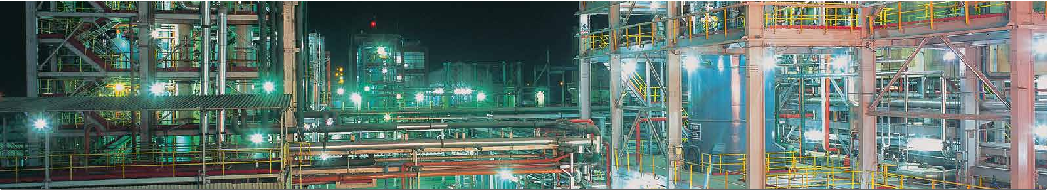
DCM SHRIRAM LTD.
AN OVERVIEW OF A 137 YEAR’S OLD GROUP
Net Revenue $135.4 bn
Agri Businesses (56%)
(Sugar & Ethanol,Shriram Farm Solutions,
Bioseed, Fertilizer)
Building Material Products (8%)
(Fenesta Building Systems)
Chemicals & Vinyl (34%)
PBDIT $16.9 bn
12 Locations
6609 Employees
PAT $8.6 bn
> 10X Water Harvested & Conserved
27% Total Energy is Green
.
.
KEY NUMBERS FOR FY 2025-26
4

Slide 5
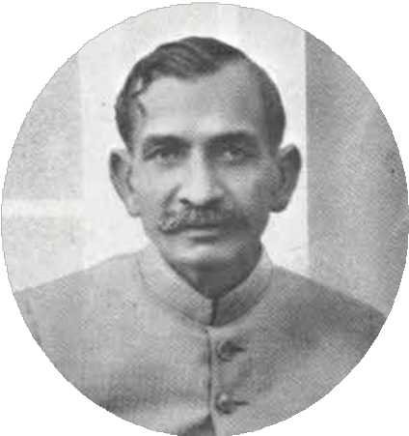
SUSTAINED ENTREPRENEURSHIP
OF OVER 137 YEARS
Our Founder - Sir Shri Ram (1884-1963)
Sir Shri Ram was an eminent and public-spirited philanthropist, an outstanding industrialist and one of the trend-setting visionary leaders of the Indian business community.
He began as a humble worker and went on to set up one of India's largest business houses - the DCM Group.
5

Slide 6





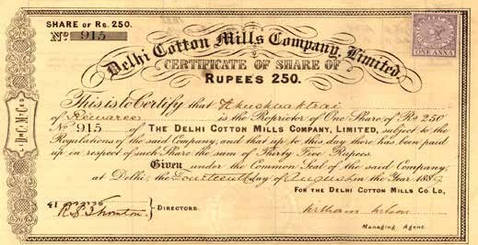
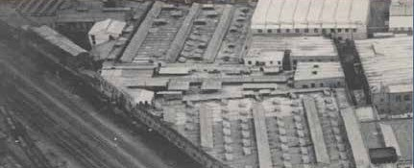
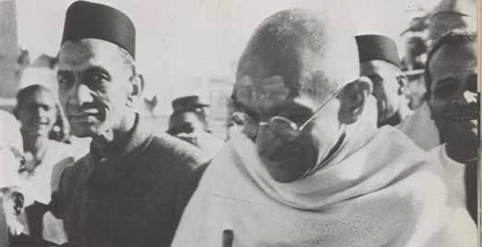
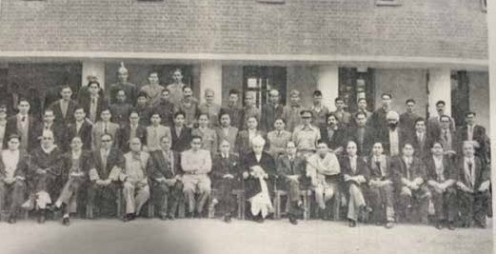
SUSTAINED ENTREPRENEURSHIP
OF OVER 137 YEARS
Delhi Cloth Mills Share Certificate in 1889
Delhi Cloth Mills aerial view in 1889
Sir Shri Ram with Gandhiji at a FICCI event
Sir Shri Ram at the SRCC inauguration in 1954
6

Slide 7
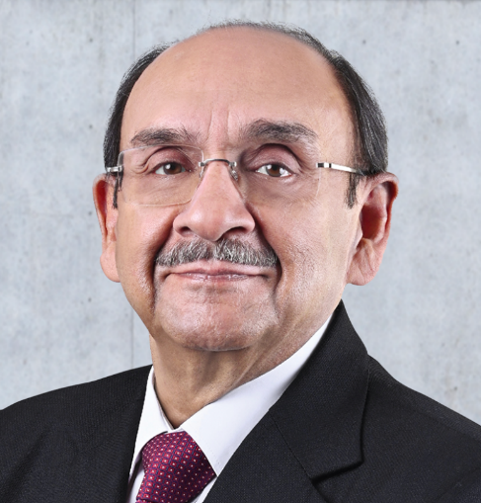
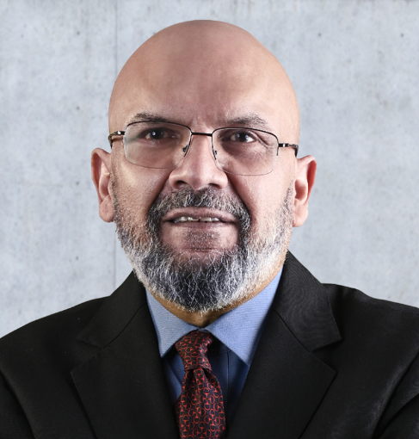
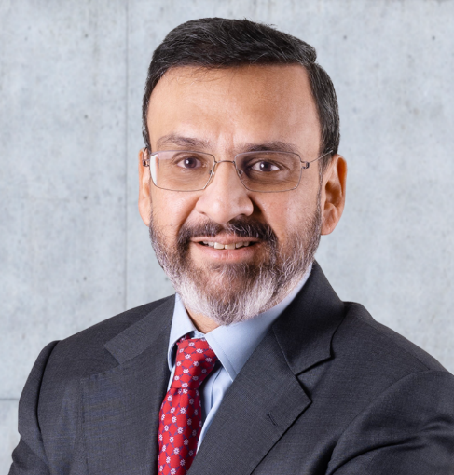
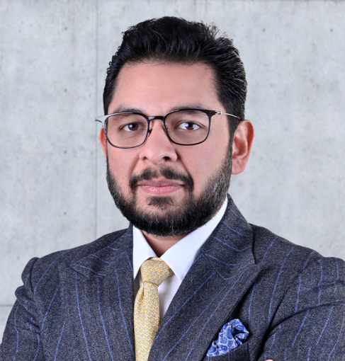
DCM SHRIRAM’S
STRONG LEADERSHIP
DCM Shriram Limited is a spin-off from the trifurcation of the erstwhile DCM Group in 1990.
The Company is organized into strategic business units managed by professional CEOs under the stewardship of promoters.
Ajay S. Shriram
Chairman & Senior Managing Director
Vikram S. Shriram
Vice-Chairman & Managing Director
Ajit S. Shriram
Jt. Managing Director
Aditya A. Shriram
Deputy Managing Director
7

Slide 8
CHANGING LANDSCAPE
Expanded all businesses in Kota & Bharuch except Fertilizers.
Acquired Sugar Unit - Rupapur and expanded Sugar Unit - Ajbapur, set up two new Sugar Units (Hariawan & Loni) in the state of UP. 5th largest Sugar producer in country.
Ventured new businesses of uPVC windows (Fenesta) and Hybrid Seeds (Bioseed), and Rural Retail (Hariyali)
Growth capex of ₹35 billion completed in the Sugar and Chemicals businesses.
Continue to build adjacent growth platforms through strategic acquisitions & partnerships:
    DNV Global (53% stake): Backward integration for Fenesta.
    HSCL (100% acquisition): Entry into advanced materials.
    PolyTek (JV with Teknor Apex): Expansion into advanced polymer solutions.
Strong Balance sheet supporting further investments
Decade Post Trifurcation 1990 to 2000
Consolidation & Sustainability 2011 to 2020
Kota Complex with Fertilizer Cement & Chloro-Vinyl businesses and Swatantra Bharat Mills (SBM)
New Caustic Soda (CS) facility in Bharuch
Acquired Ajbapur Sugar Plant in state of UP
Closed SBM
Expansion In Bharuch - 2nd largest CS producer in the country
Two new Ethanol Distilleries were set up in Sugar Mills
Rationalized Rural Retail, Bioseed International and Bulk fertilizers
Significant investments in cost optimzation
Strengthened Balance Sheet
2001 to 2010
Scale & New Businesses
2021 Onwards
8

Slide 9
OUR BUSINESSES
Agri Businesses
Chemicals & Vinyl
Building Material Products
Sugar (42,400 TCD)
Co-Gen (166 MW)
Distillery/ Ethanol (310 KLD)*
+ (250 KLD)**
Compressed Bio Gas (12 TPD)
Shriram Farm Solutions Fertilizers (379,500 TPA) Bioseed
Caustic Soda (2,749 TPD)
Hydrogen Peroxide (165 TPD)
Aluminum Chloride (150 TPD) (+100 TPD***)
Epichlorohydrine (ECH) (52,000 TPA)
Calcium Chloride (225 TPD)***
Epoxy Resins (33,551 TPA) (+36 KTPA Formulated Resins)***
Stable Bleaching Powder (120 TPD)
PVC Resins (220 TPD)
Calcium carbide (112,000 TPA)
Polymer Compounds (24,050 TPA)
Fenesta Building Systems – uPVC and
Aluminium Windows & Doors, Façade & Hardware
Others
Cement (400,000 TPA)
The business is supported by 383 MW coal based power plant, 166 MW Co-Gen and 50 MW (peak) (+126 MW peak***) renewable power.
*On B Heavy Molasses , **on Multifeed stock ***Under implementation
9

Slide 10
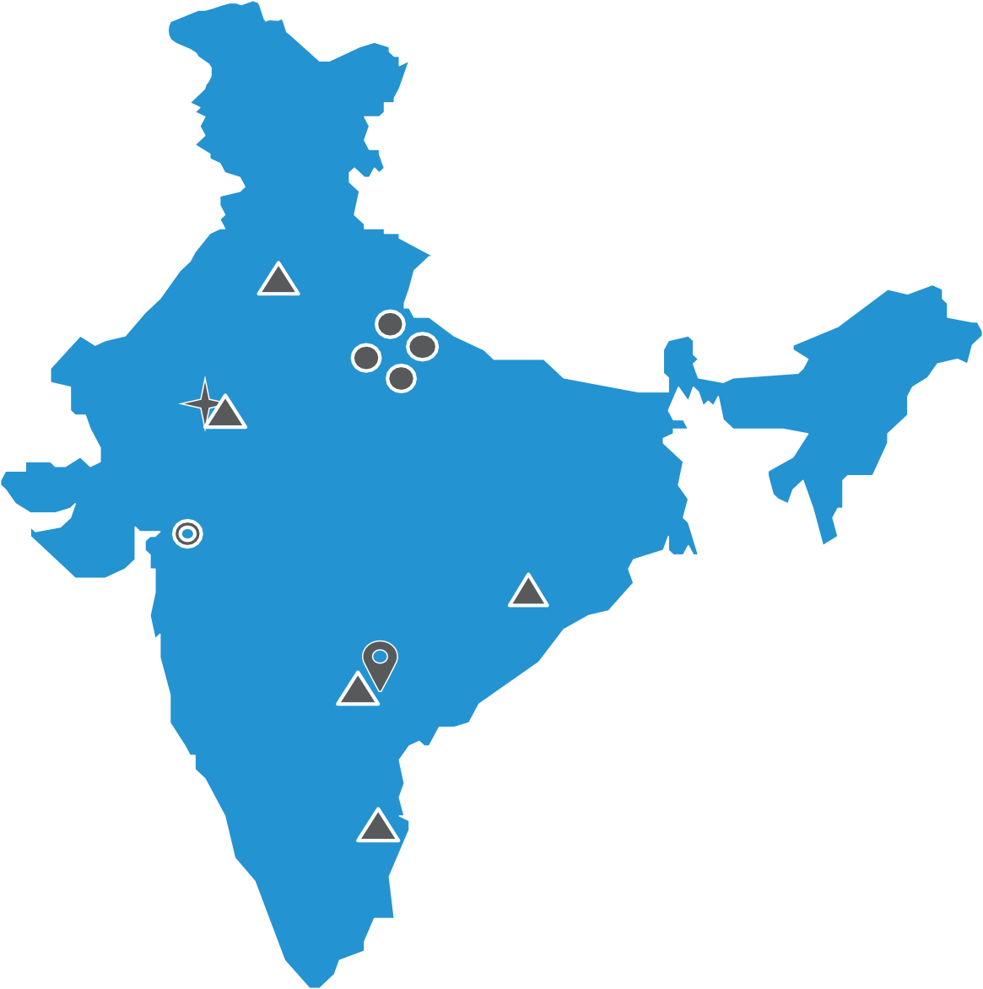




OUR PRESENCE
India
Philippines
Shriram Fertilizers & Chemicals, Kota - Rajasthan
Fenesta Building Systems, Kota, Bhiwadi, Chennai, Bhubaneswar, Hyderabad
Shriram Alkali & Chemicals, Bharuch-Gujarat, Hindusthan Speciality Chemicals
Bioseed, Hyderabad & Philippines
Sugar Production units (Central UP) – Ajbapur, Rupapur, Hariawan & Loni & Distillery Units – Ajbapur & Hariawan
10

Slide 11
BUSINESS PROFILE
Agri Businesses
Chemicals & Vinyl
Building Materials Products
Net Revenue PBIT
Capital Employed
–
–
–
75.7
7.4
46.0
Net Revenue PBIT
Capital Employed
–
–
–
46.5
5.6
54.6
Net Revenue PBIT
Capital Employed
–
–
–
Fenesta
11.11.2
2.2
Agri Output: 4 Integrated sugar complexes in State of UP (Sugar – 42,400 TCD, Power – 166 MW, Distillery – 560 KLD)
Chemicals: 2nd Largest Chlor-Alkali producer (2,749 TPD) in India with operations in States of Gujarat & Rajasthan.
Fenesta brand now a synonym to uPVC windows in India. Growing at more than 20% with presence in windows, system aluminium products, doors, façades and hardware
Others
Agri Inputs: Research based specialty plant nutrition, crop protection chemicals, seeds and Urea production
3.8 lac MT Urea plant in State of Rajasthan
Vinyl: Only carbide based PVC producer (220 TPD) in India, PVC compounding plant (24K TPA)
Others
Net Revenue PBIT
Capital Employed
–
–
–
3
-
0.4
Cement: a small facility (0.4 mn tonne) - waste management of vinyl plant
Hariyali being rationalized
Financials are in ₹/bn for FY 2026.
11

Slide 12



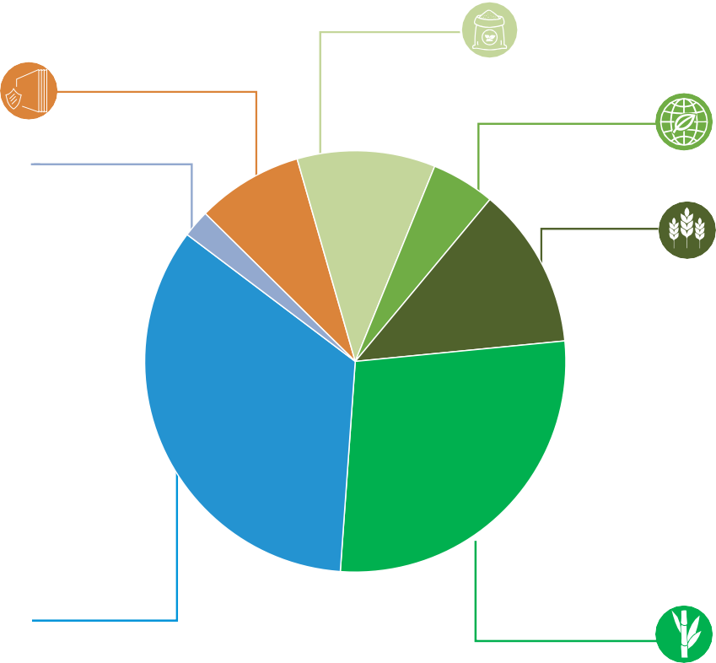
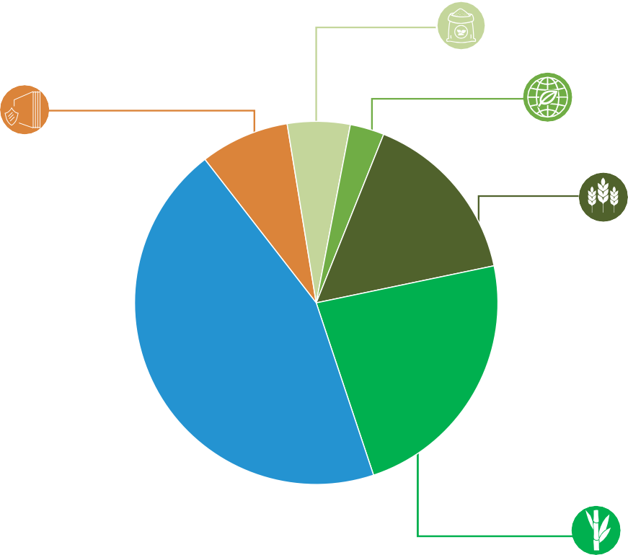






DIVERSIFIED BUSINESS
Key data for FY 2025-26
Net Revenue (`135.4 bn)
Fertilisers
11%
Fenesta
8%
Others
2%
PBDIT (`16.9 bn)
Capital Employed (`103.2 bn)
Fertilisers
6%
Fertilisers
2%
Bioseed
5%
Bioseed
3%
Fenesta
2%
Bioseed
7%
Fenesta
8%
SFS
12%
SFS
16%
Chemicals & Vinyl 34%
Chemicals & Vinyl 45%
Chemicals & Vinyl 53%
Sugar
36%
Sugar
28%
Sugar
23%
12

Slide 13
KEY FINANCIALS
Net Worth (`/bn)
Net Debt to PBDIT
80
70
77
70
65
2.5
60
61
55
2.0
50
46
40
35
40
1.5
1.3
1.3
30
30
1.1
0.8
1.3
1.3
0.9
1.0
25
1.0
0.6
20
10
0.5
0.4
0.1
0.0
2022
-
2017 2018 2019 2020 2021 2022 2023 2024 2025 2026
-
2017
2018
2019
2020
2021
2023
2024
2025
2026
ROCE (%)
Dividend Per Share (`/Share)
40
35.2
16
14.7
14.0
30.5
33.7
30
27.3
12
9.8
9.3
11.2
22.6
22.5
20.2
8.2
8.2
9.0
20
13.5
14.0
8
5.8
6.6
12.7
10
4
-
2017
2018
2019
2020
2021
2022
2023
2024
2025
2026
-
2017
2018
2019
2020
2021
2022
2023
2024
2025
2026
13

Slide 14
KEY FINANCIALS
140
135
` bn
130
40
121
120
115
109
100
96
32
78
77
83
80
69
24
60
55
62
56
58
58
50
16
35
35
41
40
24
28
26
20
8
-
-
2006 2007 2008 2009 2010 2011 2012 2013 2014 2015 2016 2017 2018 2019 2020 2021 2022 2023
PAT (10%)
2024 2025 2026
Net Revenue (9%)
PBDIT (9%)
Supported by strong balance sheet & investment philosophy
14

Slide 15




STRATEGY FRAMEWORK
Innovation and Cost
Scale, Flexibility & Integration
Financial Prudence
Strong ESG
Framework
Digital Focus
Opportunities in Adjacencies
Circular Economy
15

Slide 16


ESG -
VALUE CREATION
Natural Capital
Human Capital
51,957 TJ
Total Energy Consumption
6,609
Total Employees
27%
Green Energy consumption as % of total energy consumption
14,136 TJ
Green Energy Consumption
168,574
Total Training Hours (Employees including Contractual)
~ 41 million work hours
700 TJ
Renewable Power Consumed
2.41 million tCO e
10 Times
More Water conserved and Harvested than consumed across manufacturing sites
2
GHG Emissions
Reduction
18 hours
of Training per permanent employee per annum
Zero Liquid Discharge (ZLD) Distillery units at Hariawan and Ajbapur
26%
Material Recycled as Key Raw Materials
Zero Fatality &
0.05
Lost Time Injury Frequency Rate (LTIFR)
₹12.6 bn Employee benefits
73K Trees & 756K Mangroves planted in reporting year with
around 768K Trees and 1050K Mangroves till date
16

Slide 17



ESG -
VALUE CREATION
Social & Relationship Capital
Intellectual Capital
₹0.21 bn
Total CSR spent
R&D of hybrid seeds that are resistant to adverse weather conditions, salinity, drought, water logging, insects pests
and diseases etc.
₹0.05 bn
Preventive healthcare and Sanitation
₹0.05 bn
Education, Skilling and Livelihood
₹0.07 bn Environmental Sustainability
₹0.03 bn Rural development
Beneficiaries:
8.040 Farmers | 120 Villages covered in Rural India
24,750 Trees planted | 7,56,000 Mangrove Plantation | 3,90,451 m³ water storage created
8,550+ Households reached in Rural India
4,300+ Students reached | 4,200+ Mothers engaged | 600 Community members engaged
14,400+ Mobile Health Unit beneficiaries
    355+ rural youth trained | 310 Rural youth placed | ₹15K–₹16K Average Monthly Income
1026 MT Wet Waste collected | 93 MT Total Compost prepared
256 AEs Trained | ₹ 48.1 Cr Revenue Generated | ₹ 9.5 Cr Revenue generated through ancillary business
120 Granted
from 154 Plant Variety Protection (PVP) registrations filed till date
5 patents for Inventions granted in up to 52 jurisdictions each filed till date
17

Slide 18
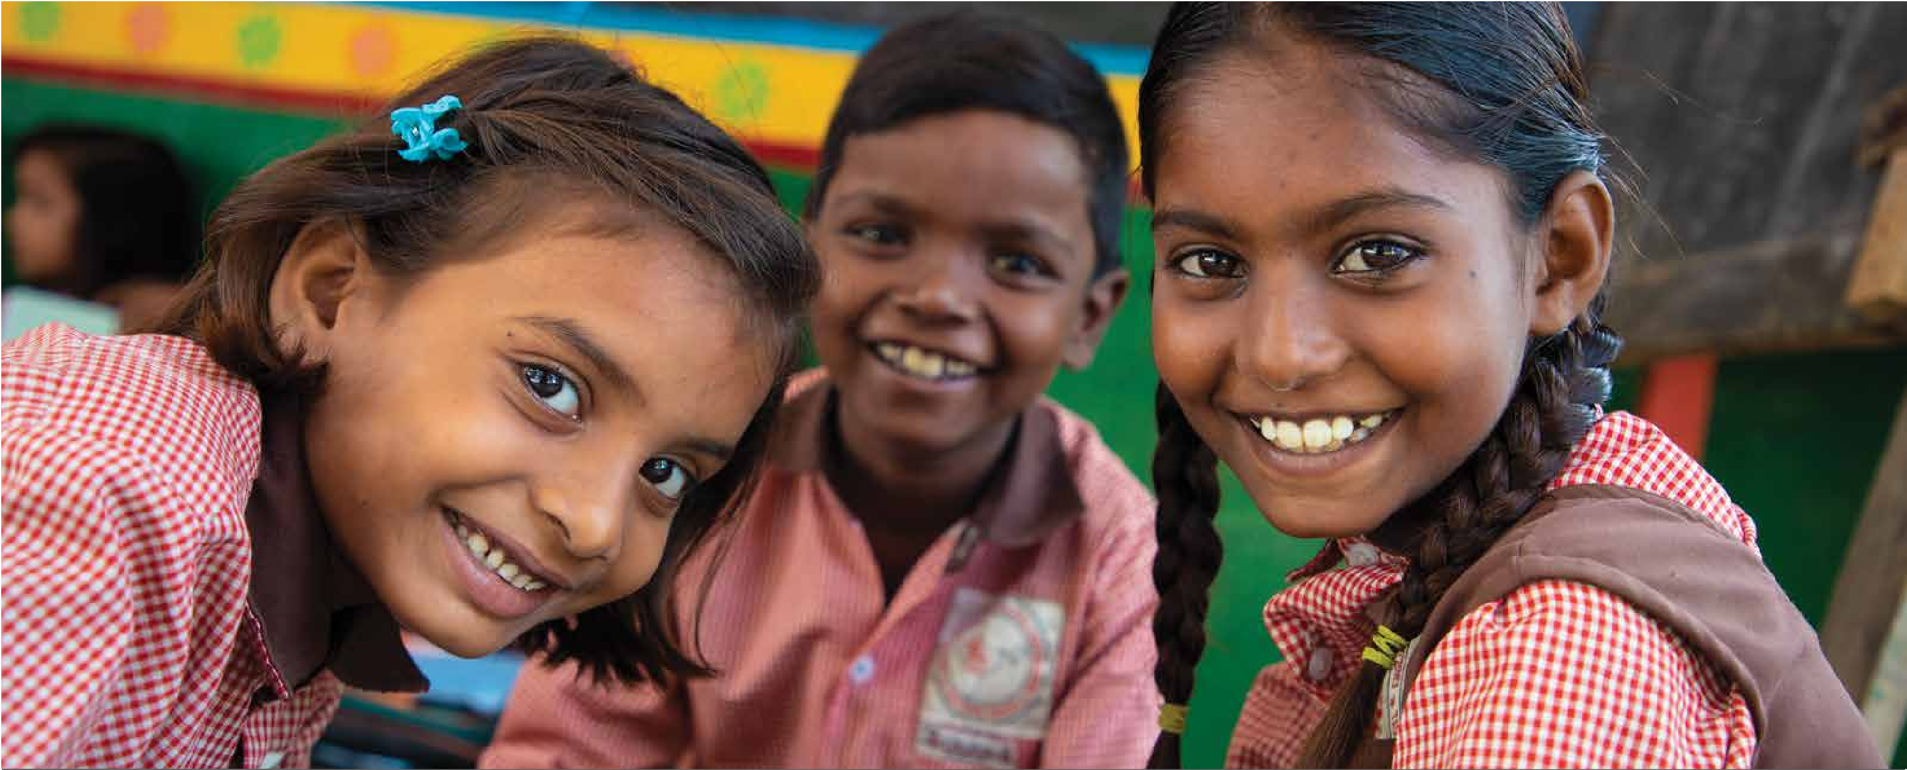
CORPORATE
SOCIAL RESPONSIBILITY

Slide 19



CSR PROGRAM APPROACH
@ DCM SHRIRAM LTD
DCM Shiram Ltd undertakes its CSR activities through it’s Philanthropic arm DCM Shriram Foundation with key focus areas of:
FOCUS AREA A
FOCUS AREA B
CLIMATE SUSTAINABLE AGRICULTURE
Knowledge
Advocacy
Catalytic Innovation
Ecosystem Building
Initiative
HOLISTIC DEVELOPMENT
Jeetega Kisaan
Khushali Sehat
A Preventive Healthcare Initiative
Khushali Swachhata
A Sanitation Initiative
Khushali Shiksha
An Education Initiative
Khushali Rozgaar
A Livelihood Initiative
Khushali Paryavaran
An Environmental Sustainability Initiative
Systems Thinking . Lifecycle Development . Government Convergence
19

Slide 20

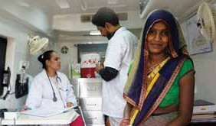
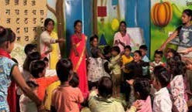
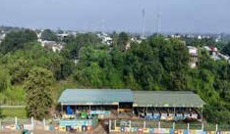
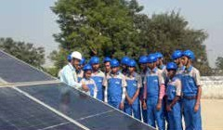
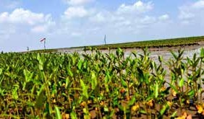
CORPORATE SOCIAL RESPONSIBILITY
KHUSHALI (MEANS “PROSPERITY”) PROGRAM DRIVEN THROUGH 5 PILLARS
(AN INTEGRATED DEVELOPMENT PROGRAM MODEL)
Khushali Sehat
Khushali Shiksha
Khushali Swachhata
Khushali Rozgaar
Khushali Paryavaran
A Health Initiative
An Education Initiative
A Sanitation Initiative
A Livelihood Initiative
An Environmental Sustainability Initiative
To improve maternal, child, and community health outcomes through preventive healthcare, nutrition, and strengthened frontline health systems. The program focuses on awareness, early intervention, and access to quality healthcare services in underserved communities.
To enhance access to quality education and strengthen foundational learning for children and youth. The program supports ECCE, school readiness, digital learning, and community participation in education.
To build cleaner and healthier communities through sustainable solid waste management systems. The program promotes waste segregation, recycling, and community-led behaviour change.
To improve employability and create sustainable livelihood opportunities for youth and women. The program promotes industry-aligned skilling, entrepreneurship, and
income generation initiatives.
Khushali Parya varan (An Environmental Sustainability Initiative)To conserve natural resources and strengthen environmental sustainability in and around communities. The program supports water conservation, plantation drives, biodiversity restoration, and climate resilience.
20

Slide 21
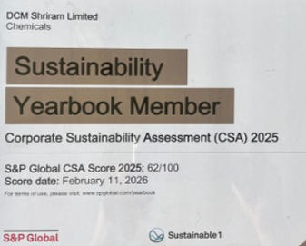
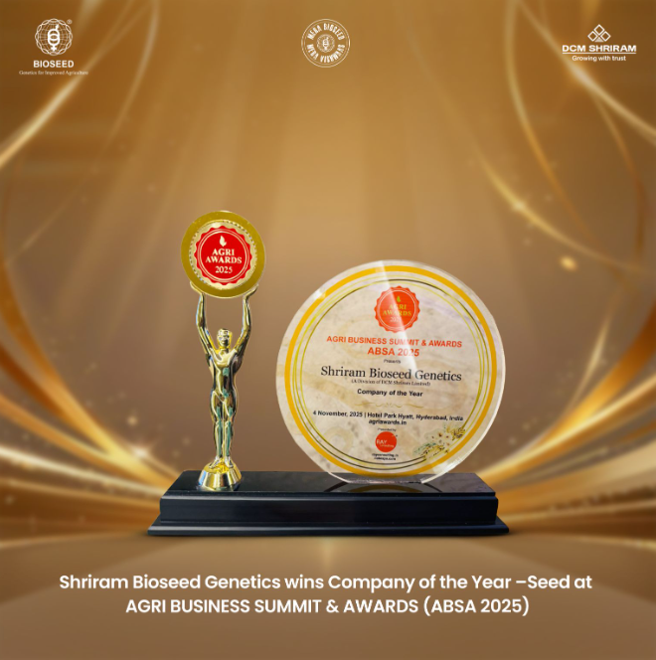
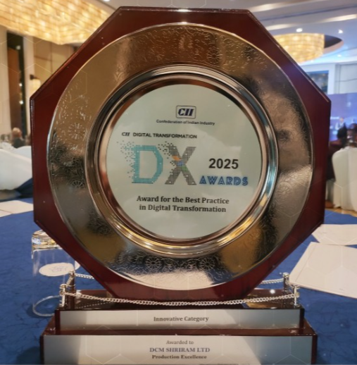


AWARDS & ACCOLADES
AWARDS & RECOGNITIONS
DCM Shriram received Yearbook Member distinction in the S&P Global Sustainability Yearbook 2026
Shriram Bioseed Genetics wins Company of the Year – Seed at the Agri Business Summit & Awards 2025
DCM Shriram Chemicals won the DX Award 2025 for ‘Innovative’ Best Practice in Digital under the Production Excellence category Transformation by the Confederation of Indian Industry (CII).
Fenesta recognized as the Iconic Brands of India 2025 by ET Now
DCM Shriram Chemicals' Jhagadia site joined the World Economic Forum's Global Lighthouse Network and recognized in the Distinction in Productivity category
21

Slide 22





Thank you

